Slide 1


Multi Model Capacitated Vehicle Routing and Suggestions on Efficient Route Planning
Efficient Solutions for Vehicle Routing Challenges

Slide 2

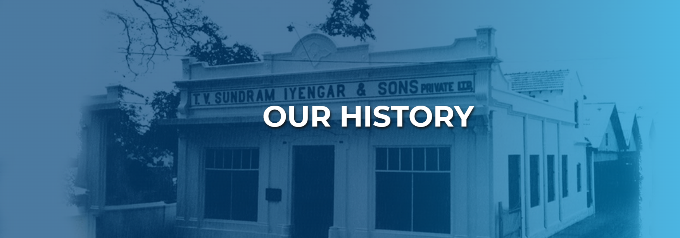
Company was promoted by the erstwhile TVS & Sons, which had over 100 years of operating history. Company has commenced operations as ‘TVS Logistics’ in 1995 before being incorporated as a separate company in 2004. Company’s culture and philosophy of doing business is defined by building trust and putting customers first and continuously improving our offerings. Company’s business is focused on helping customers achieve their cost and revenue goals by aiming to deliver high levels of productivity, ensure customer experience with efficiency and provide digital-ready platform and innovation driven solutions.

Slide 3
| WHAT COMPANY DO |
Services
Integrated Supply Chain Solutions (ISCS)
Consultancy & Professional Services
Network Solutions
Global Forwarding Solutions (GFS)
Product Management Solutions
Manufacturing Support
Warehousing, Storage & Distribution
Transportation & Integrated Logistics
Integrated Packaging Solutions
Information Systems
Sourcing and Procurement
Time Critical Final Mile Solutions

Slide 4
| SECTORS COMPANY SERVE |
Industries
Automotive
Industrial
Tech and Tech Infra
Beverage
Consumer (Includes FMCG/FMCD)
Defence
E-Commerce and Omnichannel
Healthcare
Rail
Telecom
Utilities
Financial Services
Others

Slide 5
| COMPANY SERVE |
Automotive
Company’s automotive-related solutions include aftermarket support, spare parts distribution, point of use feeding, Value-add assembly, kitting, and sequencing. Whether you would like a single solution or a complete end-to-end supply chain design, TVS SCS can deploy a customized solution to meet your requirements.
Parts provision – Original Equipment (OE) or Aftermarket, is supported through Inventory Planning, allowing for reduced inventory costs while preserving service levels and parts availability. It is creating a supply chain that is responsive throughout the product lifecycle, global procurement, Warehousing and Distribution to support dealer and distribution networks and supporting line side.

Slide 6
| COMPANY SERVE |
Beverage
TVS SCS is a global provider of world-class, end-to-end supply chain services to the beverage and catering sectors.
Your brands are company’s business. Company understand that, to gain a competitive edge, you must be different. Company tailor their supply chain solutions so that they deliver what you need. Whether your market is beer, soft drinks, coffee or events catering, company help you take control of your supply chain. Company ensure that the right part is delivered to the right place at the right time, every time. Company drive down costs and provide technical expertise, from the sourcing of raw materials right through to the installation and support of your equipment. Ensuring your clients receive an outstanding customer service experience whilst allowing you to focus on the core competency of your business.

Slide 7
| PROBLEM STATEMENT |
Capacitated Vehicle Routing
Company has PAN India warehouses. And PAN India customers where we have to deliver some packages, dimensions (weight/volume/quantity) of each package are given. We have tie up with a company which provide us different type of vehicles (with different capacities) for the same. Let us assume demand at each customer node is known in advance. Company has to do routing for each of the warehouse such that each customer should be served and minimize the total distance to be covered. Suggest minimum number of vehicles of each type to be rented for efficient routing.
Two type of routing has to be done:
Incity (Two – way)
Upcountry (One – way)

Slide 8

Understanding Capacitated Vehicle Routing Problem (CVRP)
Logistics and Transportation Management
Integral problem in optimizing delivery operations and managing transportation efficiently.
| LOGISTICS OPTIMIZATION |
Efficient Route Planning
Determining optimal paths for a fleet to deliver goods while meeting capacity limits.
Key in Optimization
Fundamental challenge in logistics that requires strategic planning and efficient solutions.
Exploring the Significance of CVRP in Optimization

Slide 9
| OVERVIEW |
Deciphering Capacitated Vehicle Routing Problem
Exploring Components and Constraints of CVRP
Depots, Vehicles, and Customers
CVRP involves depots, vehicles, and customers with demands.
Limited Vehicle Capacity
Unique Customer Visits
Each customer is visited exactly once by one vehicle.
Minimization Objective
Objective is to minimize total distance or time traveled.
Vehicles have restricted capacity in CVRP scenarios.

Slide 10
| METHODS TO SOLVE VRP |
Vehicle Routing Problem
Exact Methods:
These methods guarantee to find the optimal solution, but they can be computationally expensive or infeasible for large problems.
Integer Programming: This involves formulating the VRP as a mathematical model with variables and constraints, and then using specialized solvers to find the optimal solution.
Branch and Bound: This method explores the solution space systematically, branching on decisions and eliminating parts of the search space that cannot contain the optimal solution.
Heuristic Methods:
Heuristic methods provide good solutions within reasonable computation times but do not guarantee optimality. They are often used for larger problems where exact methods are complex to handle.
Savings Algorithm (Clarke-Wright Savings Algorithm): This method starts with each customer being served by a separate route and iteratively merges routes to reduce the total distance traveled.
Nearest Neighbor: This simple heuristic starts at a depot and repeatedly visits the nearest unvisited customer until all customers are served.

Slide 11
| ASSUMPTIONS |
Capacitated Vehicle Routing
Homogeneous Fleet: All vehicles in the fleet are identical in terms of capacity, speed, and other relevant factors.
Euclidean Distance: Distances between nodes (customers or delivery points) are calculated using haversine formula. This assumption simplifies the calculation of distances but may not always reflect real-world road networks accurately.
Demand Quantity: Each customer has a known demand for goods/services that need to be delivered. This demand does not change during the planning horizon.
Single Visit: Each customer is visited exactly once by exactly one vehicle.
Multiple Locations: One vehicle can serve multiple locations.
Stationary Environment: The environment, such as road conditions and traffic, is assumed to be constant throughout the planning horizon.

Slide 12
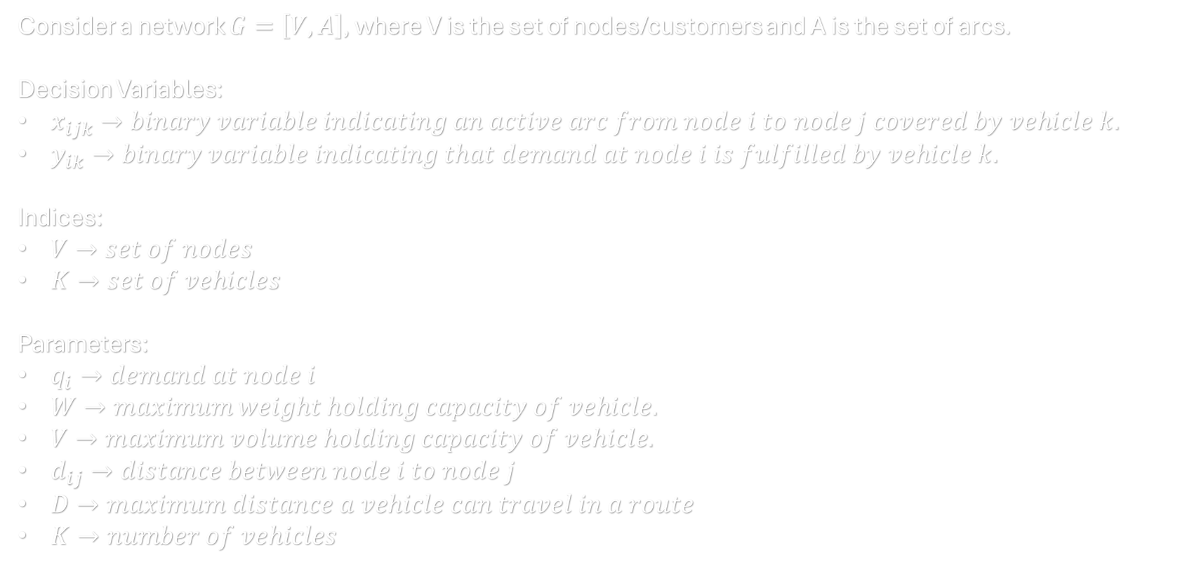
| PROBLEM FORMULATION |
Vehicle Routing Problem
Consider a network $G=\left[V, A\right]$, where V is the set of nodes/customers and A is the set of arcs.
Decision Variables:
$x_{ijk}→binary variable indicating an active arc from node i to node j covered by vehicle k.$
$y_{ik}→binary variable indicating that demand at node i is fulfilled by vehicle k.$
Indices:
$V→set of nodes$
$K→set of vehicles$
Parameters:
$q_{i}→demand at node i$
$W→maximum weight holding capacity of vehicle.$
$V→maximum volume holding capacity of vehicle.$
$d_{ij}→distance between node i to node j$
$D→maximum distance a vehicle can travel in a route$
$K→number of vehicles$

Slide 13
| PROBLEM CONSTRAINTS |
Vehicle Routing Problem
Incity Routing
Each 𝑐𝑢𝑠𝑡𝑜𝑚𝑒𝑟 𝑖 is visited once, therefore has one active arc which starts from it and one that arrives on it.
Upcountry Routing
Each 𝑐𝑢𝑠𝑡𝑜𝑚𝑒𝑟 𝑖 is visited once, therefore has one active arc which starts from it and one that arrives on it except one arc which ends at depot.
The total demand (weight) assigned to a vehicle must not exceed its 𝑐𝑎𝑝𝑎𝑐𝑖𝑡𝑦 𝑊.
The total demand (volume) assigned to a vehicle must not exceed its 𝑐𝑎𝑝𝑎𝑐𝑖𝑡𝑦 𝑉.
The distance assigned to any vehicle in a route should not exceed its maximum travelling capacity.
Exactly 𝑘 vehicles should start and arrive at the 𝑤𝑎𝑟𝑒ℎ𝑜𝑢𝑠𝑒.
There are no subtours.
All the decision variables are binary.
If any arc variable indexed by 𝑣𝑒ℎ𝑖𝑐𝑙𝑒 𝑘 goes into one 𝑛𝑜𝑑𝑒 𝑖 or out of it, the 𝑑𝑒𝑚𝑎𝑛𝑑 of this node is assigned to 𝑣𝑒ℎ𝑖𝑐𝑙𝑒 𝑘.
If any arc variable indexed by 𝑣𝑒ℎ𝑖𝑐𝑙𝑒 𝑘 goes into one 𝑛𝑜𝑑𝑒 𝑖 or out of it, the 𝑑𝑒𝑚𝑎𝑛𝑑 of this node is assigned to 𝑣𝑒ℎ𝑖𝑐𝑙𝑒 𝑘.
The total demand (weight) assigned to a vehicle must not exceed its 𝑐𝑎𝑝𝑎𝑐𝑖𝑡𝑦 𝑊.
The total demand (volume) assigned to a vehicle must not exceed its 𝑐𝑎𝑝𝑎𝑐𝑖𝑡𝑦 𝑉.
The distance of any arc containing any two locations except depot should not exceed the maximum distance assigned to the arc.
No more than 3 customers should be assigned to any particular route/vehicle.
Exactly 𝑘 vehicles should start from the 𝑤𝑎𝑟𝑒ℎ𝑜𝑢𝑠𝑒.
No vehicle should return to the depot.
There are no subtours.
All the decision variables are binary.

Slide 14
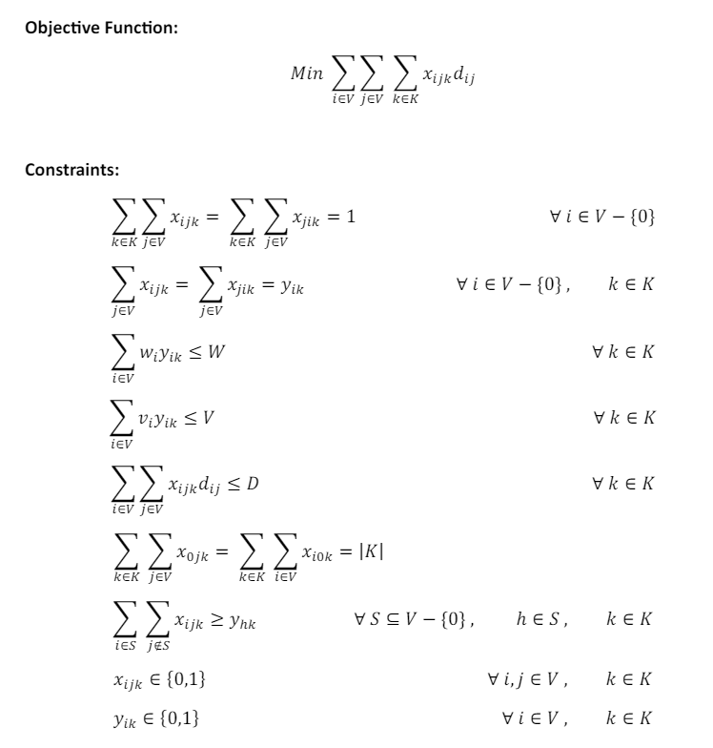
| MATHEMATICAL MODELING |
Incity Vehicle Routing

Slide 15
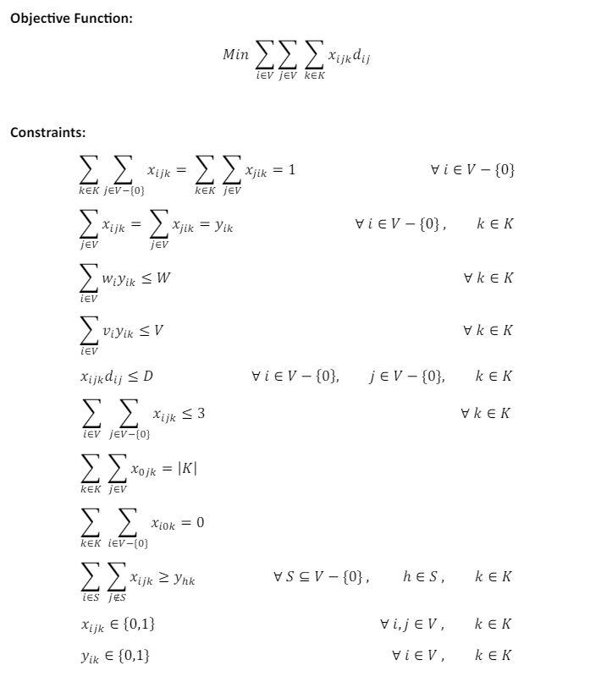
| MATHEMATICAL MODELING |
Upcountry Vehicle Routing

Slide 16


1
Efficiency over Optimality
Heuristics prioritize speed and practicality in problem-solving.
2
Dealing with Complexity
Heuristics play a crucial role in addressing NP-hard problems like CVRP.
3
ORTools Heuristics
ORTools in Python offers efficient heuristics for solving complex optimization problems.
| HEURISTICS & OPTIMIZATION |
Heuristics in Solving CVRP with ORTools Python
Understanding the Role of Heuristics in Tackling Optimization Problems

Slide 17

| EFFICIENCY ANALYSIS |
Efficient Heuristic Approaches for CVRP
Exploring Key Heuristics Methods for Capacitated Vehicle Routing Problem
Nearest Neighbor Algorithm
Quickly identifies the nearest unvisited customer from the current location.
Savings Algorithm
Groups customers into clusters to optimize vehicle routes and minimize total distance.

Slide 18

| HEURISTIC ALGORITHMS |
Utilizing ORTools Heuristics in Python
Exploring CVRP Solutions with Heuristic Algorithms in ORTools
Clarke & Wright Savings Algorithm
Implement heuristic algorithms like Clarke-Wright savings in ORTools for CVRP.
Efficient Solution Finding
Leverage ORTools to identify near-optimal solutions for CVRP instances.

Slide 19
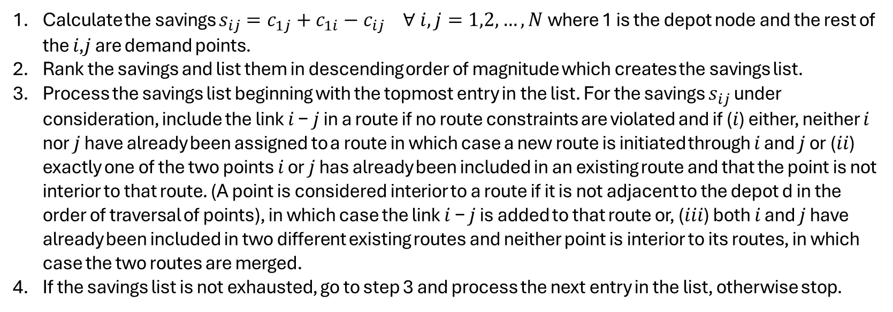
| ALGORITHM IMPLEMENTATION |
Clarke & Wright Savings Algorithm
Calculate the savings $s_{ij}=c_{1j}+c_{1i}−c_{ij} ∀ i,j=1,2, …, N$ where 1 is the depot node and the rest of the 𝑖,𝑗 are demand points.
Rank the savings and list them in descending order of magnitude which creates the savings list.
Process the savings list beginning with the topmost entry in the list. For the savings $s_{ij}$ under consideration, include the link 𝑖 − 𝑗 in a route if no route constraints are violated and if (𝑖) either, neither 𝑖 nor 𝑗 have already been assigned to a route in which case a new route is initiated through 𝑖 and 𝑗 or (𝑖𝑖) exactly one of the two points 𝑖 or 𝑗 has already been included in an existing route and that the point is not interior to that route. (A point is considered interior to a route if it is not adjacent to the depot d in the order of traversal of points), in which case the link 𝑖 − 𝑗 is added to that route or, (𝑖𝑖𝑖) both 𝑖 and 𝑗 have already been included in two different existing routes and neither point is interior to its routes, in which case the two routes are merged.
If the savings list is not exhausted, go to step 3 and process the next entry in the list, otherwise stop.

Slide 20
Let’s get started

Slide 21
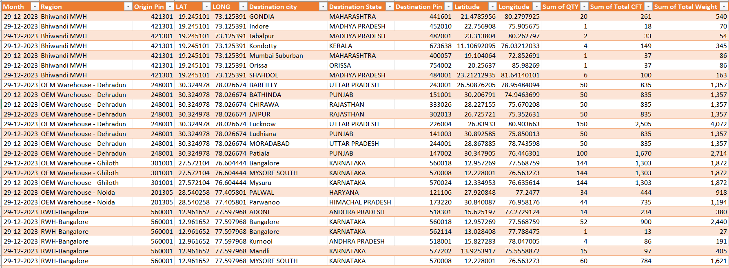
| DATASET PREVIEW |
Warehouse & Customer Locations with their Demands

Slide 22
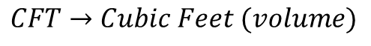
| VEHICLE DETAILS |
Vehicle and their capacities
Truck Type | Length | Width | Height | Max Weight (Ton) | Maximum CFT | Usable CFT
Tata Ace (100 KM) | 7 | 4.8 | 4.8 | 0.85 | 161 | 80.64
Mahindra Bolero Pickup (250 KM) | 8 | 4.8 | 4.8 | 1.5 | 184 | 92.16
Eicher 14 Feet (400 KM) | 14 | 6 | 6.5 | 4 | 546 | 409.5
Eicher 17 Feet | 17 | 6 | 7 | 5 | 714 | 535.5
Eicher 20 Feet | 20 | 8 | 7 | 7 | 1120 | 840
CONTAINER 32 FT SXL | 32 | 8 | 8 | 7 | 2048 | 1536
$$CFT→Cubic Feet (volume)$$

Slide 23
Bhiwandi MWH

Slide 24
| RESULTS |
Bhiwandi MWH – Incity Routing
Vehicle 1: Tata Ace Distance covered: 82 KM
Bhiwandi MWH
421301
Mumbai Suburban
400057
W:87 V:38

Slide 25
| RESULTS |
Bhiwandi MWH – Upcountry Routing
Vehicle 1: Eicher 17 Feet Distance covered: 607 KM
Bhiwandi MWH
421301
Indore
452010
W:70 V:18

Slide 26
| RESULTS |
Bhiwandi MWH – Upcountry Routing
Vehicle 2: Eicher 17 Feet Distance covered: 983 KM
Bhiwandi MWH
421301
GONDIA
441601
W:541 V:262

Slide 27
| RESULTS |
Bhiwandi MWH – Upcountry Routing
Vehicle 3: Eicher 17 Feet Distance covered: 1261 KM
Bhiwandi MWH
421301
Jabalpur
482001
W:55 V:34
SHAHDOL
484001
W:163 V:101

Slide 28
| RESULTS |
Bhiwandi MWH – Upcountry Routing
Vehicle 4: Eicher 17 Feet Distance covered: 1197 KM
Bhiwandi MWH
421301
Kondotty
673638
W:346 V:149

Slide 29
| RESULTS |
Bhiwandi MWH – Upcountry Routing
Vehicle 5: Eicher 17 Feet Distance covered: 1688 KM
Bhiwandi MWH
421301
Orissa
754002
W:87 V:38

Slide 30
RWH-Kolkata

Slide 31
| RESULTS |
RWH Kolkata – Incity Routing
Vehicle 1: Tata Ace Distance covered: 62 KM
RWH-Kolkata
711302
Howrah
711303
W:134 V:26

Slide 32
| RESULTS |
RWH Kolkata – Upcountry Routing
Vehicle 1: Eicher 14 Feet Distance covered: 261 KM
RWH-Kolkata
711302
JAMSHEDPUR
831012
W:272 V:167
JAMSHEDPUR
831006
W:163 V:101

Slide 33
| RESULTS |
RWH Kolkata – Upcountry Routing
Vehicle 2: Eicher 17 Feet Distance covered: 631 KM
RWH-Kolkata
711302
Berhampur
760001
W:541 V:262

Slide 34
| RESULTS |
RWH Kolkata – Upcountry Routing
Vehicle 3: Container 32 FT SXL Distance covered: 1629 KM
RWH-Kolkata
711302
NEW DELHI
110085-1
W:2471 V:1520

Slide 35
| RESULTS |
RWH Kolkata – Upcountry Routing
Vehicle 4: Eicher 17 Feet Distance covered: 1629 KM
RWH-Kolkata
711302
NEW DELHI
110085
W:245 V:151

Slide 36
| FINAL RESULTS |
Number of vehicles of each type to be rented
Truck Type | Count
Tata Ace (100 KM) | 7
Mahindra Bolero Pickup (250 KM) | 3
Eicher 14 Feet (400 KM) | 15
Eicher 17 Feet | 42
Eicher 20 Feet | 15
CONTAINER 32 FT SXL | 29
Total No. of Trips: 111

Slide 37


